Slide 1
BCA Final Year Project (Review I) Prediction of Heart Disease Risk Based on Lifestyle Factors Using Machine Learning
Submitted to the Presidency University, Bengaluru in partial fulfilment for the award of the degree of Bachelor of Computer Applications(BCA)
Project Team No : 81
Under the supervision of
Mr. Afroj Alam Assistant Professor, School of Information Science
Name | Roll Number
Krishna Kumar M | 20231BCD0014
Siri Ponnala Revanth | 20231BCD0031
Kushal Ghimirey | 20231BCD0055
Rahul S.Menon | 20231BCD0049

Slide 2
Content
Problem Statement
Literature Survey
Tools and Technologies to be used
Timeline of the Project
Github Link
References

Slide 3
Problem Statement
Heart disease risk is strongly influenced by lifestyle and physiological factors, yet early predictive tools remain limited.
Our project aims to develop and compare machine learning and deep learning models to accurately predict heart disease risk using structured health data.
Provide personalised lifestyle recommendations for risk analysis.

Slide 4
Literature Review
Focus on ML and DL based heart disease risk prediction using lifestyle and physiological data[1]
Include studies using Logistic Regression, Random Forest, SVM, XGBoost, and Neural Networks.
Prioritise papers reporting accuracy, recall, and ROC-AUC for cardiovascular prediction.
Traditional machine learning approaches for heart disease prediction.
Deep learning methods applied to structured healthcare data.

Slide 5
Comparative studies between ML and DL models.
Decision-support and recommendation systems in healthcare.
Most studies report strong performance of Random Forest and ensemble methods on tabular medical data.
Deep learning shows promise but does not always outperform classical ML on structured datasets.
Feature selection and data preprocessing significantly affect prediction accuracy.
Many existing systems focus only on prediction and lack personalized lifestyle recommendations.

Slide 6
Module Design
The system follows a modular architecture to ensure clear functionality, scalability, and easy maintenance.
Purpose of Modularity
Improves organisation and readability
Enables independent testing
Simplifies maintenance and upgrades

Slide 7
Module Design
Module 1: Data Collection
Loads and validates healthcare dataset
Prepares raw data for processing
Role: Acquire and verify input data.
Module 2: Data Processing & Model Training
Performs preprocessing and feature scaling
Splits data and trains ML/DL models
Evaluates model performance
Role: Convert raw data into predictive models.

Slide 8
Module Design
Module 3: Risk Prediction & Recommendation
Predicts heart disease risk
Generates personalised lifestyle suggestions
Provides decision-support output
Role: Deliver actionable health insights.

Slide 9
Tools And Technologies To Be Used
- Development Tools: [Jupyter ,Google colab and PowerBi]
- Programming Languages: [Python]
- Libraries: [Scikit-learn, pandas, numpy]
- Version Control: [Git and GitHub]

Slide 10
Github Link
Github Link
https://github.com/rokuta0/heart-disease-prediction

Slide 11
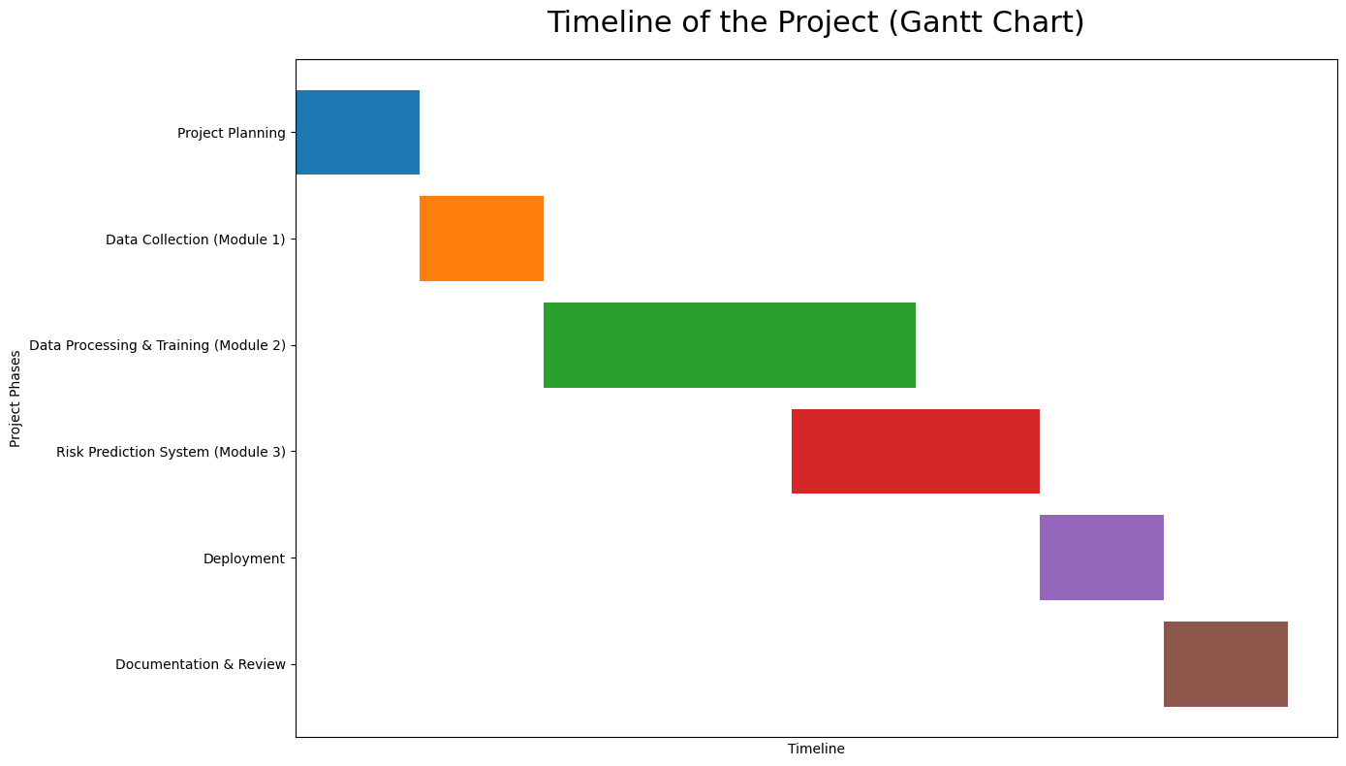

Slide 12
References (IEEE Paper format)
Ghongade, O. S., et al. “A Comparison of Neural Networks and Machine Learning Methods for Prediction of Heart Disease.” Computational Techniques (ICCT),2023, pp. 1–7, https://ieeexplore.ieee.org/document/10076174
Apurb Rajdhan, Avi Agarwal, Milan Sai, Dundigalla Ravi, Dr. Poonam Ghuli Student CSE, R V College of Engineering, Bengaluru, India ,Associate Professor, R V College of Engineering, Bengaluru, India

Slide 13


